Slide 1

Welcome to
Reception!
Show respect
Be determined
Make good choices
Be the best you can be!
Use kind words
Have a go!

Slide 2
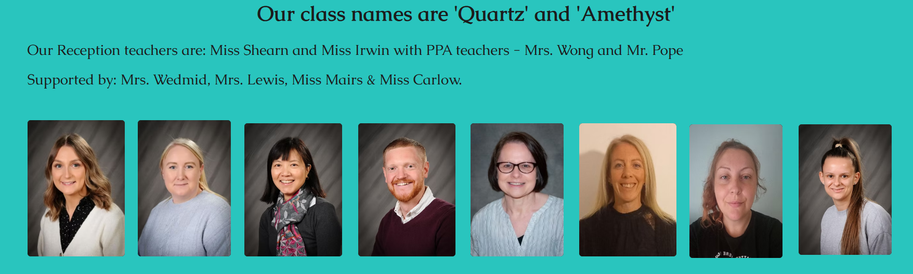
Our Team
Show respect
Be determined
Make good choices
Be the best you can be!
Use kind words
Have a go!

Slide 3
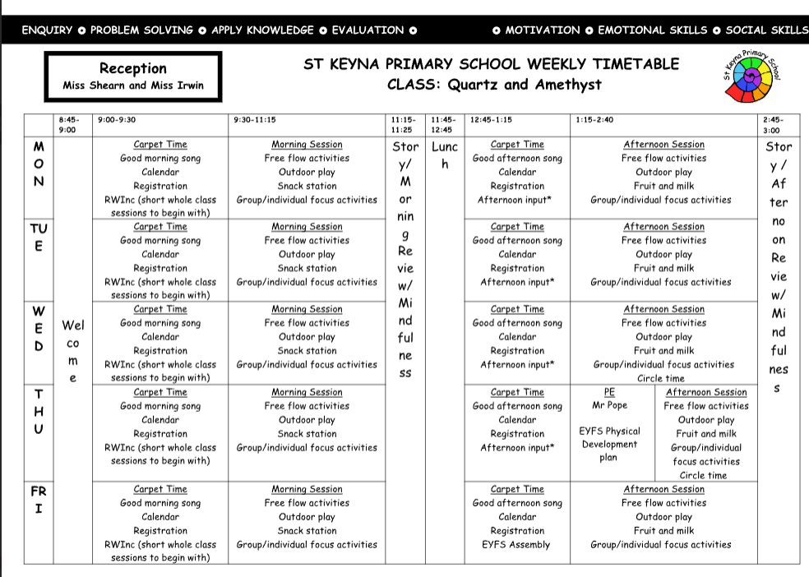
Reception Weekly Overview

Slide 4

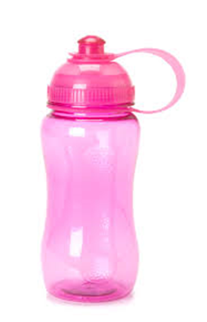
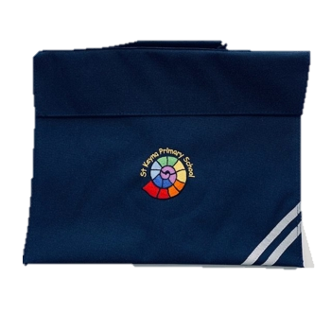
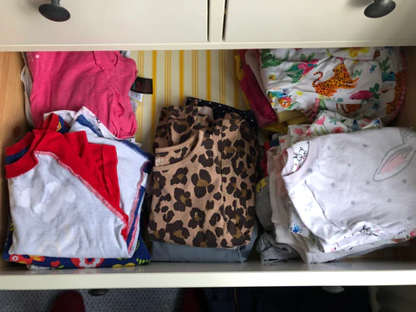
Uniform
Children expected to wear school uniform – please name all items. Wellington boots. Hats. Coats
Earrings (studs only) – removed or taped up for PE.
PE Kits – white t-shirt and black shorts, leggings or tracksuit bottoms.
.
What do they need every day?
Coat
Water bottle
Book bag
Change of underwear/clothes

Slide 5
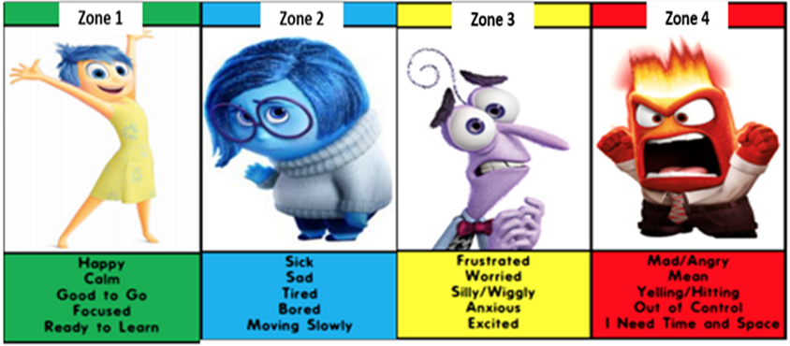
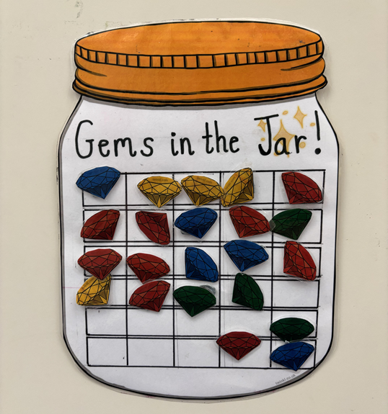
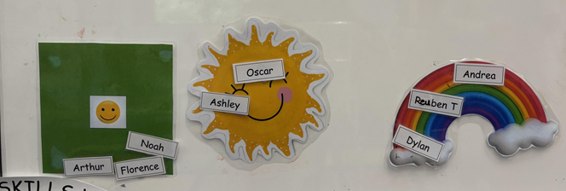
Positive Behaviour Policy and Rewards
Adults notice the children's behaviour and either praise them for it or support them with understanding the cause for it. Then we work together to create a natural consequence for their behaviour.
They will also help the children understand how they can learn from it to improve their behaviour in the future.
Reception Positive Behaviour Chart
Everyday, children start on the green and if we see positive behaviour they work up the chart. They move to the sun first, followed by the rainbow. When they get to the rainbow, a gem is put into the jar. When the Gem Jar is full, the children get to pick a class prize!

Slide 6
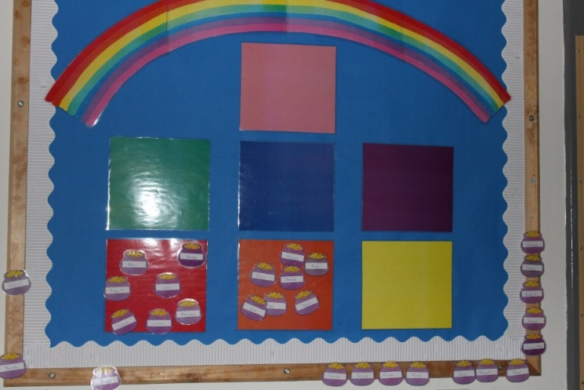
Reading in school
Otherwise known as enjoying sharing story books together!
Minimum of 3 times per week.
Talk about stories – where they take place, the characters. Instead of reading, let your child help to retell a well known story.
Write title in reading record book with the date and sign.
Reading Rewards
Rainbow Reading Challenge – Dojo points, certificates, new book as prize when reach the rainbow.
Books will be changed every Monday for Quartz and Tuesday for Amethyst.

Slide 7

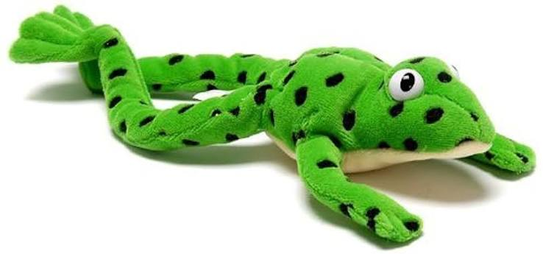
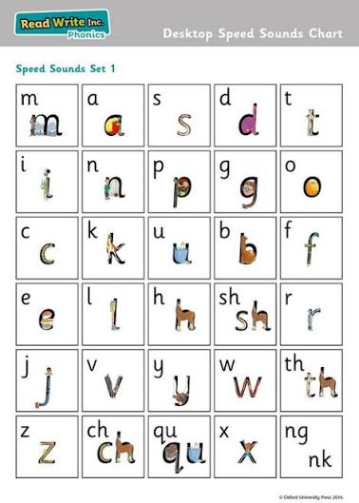
RWInc
What is Read Write Inc.?
Read Write Inc. is a phonics programme that teaches children how to read and write words by learning the sounds that letters make.
The Scheme teaches children to:
Recognise the sounds represented by letters and groups of letters.
Say the sounds clearly.
Blend sounds together to read words.
Segment words into sounds to help spell them.
Read simple words and sentences.
Build confidence and develop a love of reading.
For example, when a child sees the word cat, they learn to say:c – a – t → cat

Slide 8
RWInc
What will my child learn first?
When children begin RWI, they will start by learning the initial sounds and how to recognise and write them.
You may hear your child talking about "Set 1 sounds". These are the first sounds children learn, such as:
m, a, s, d, t, i, n, p, g, o, c, k
They will gradually learn more sounds and begin putting them together to read words.
Children will also learn "special friends" – two or more letters that work together to make one sound, for example:
sh, ch, th, ng
As they become more confident, they will learn further sounds and begin reading increasingly complex words.

Slide 9
RWInc
At the beginning of phonics, we focus on the sound a letter makes rather than its letter name.
For example:
m = "mmmm"
s = "ssss"
f = "ffff"
This helps children when they begin blending sounds together to read words.
Try to avoid adding an "uh" sound to letters. For example, say "mmmm" rather than "muh". This makes blending much easier.

Slide 10
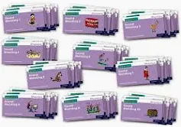
RWInc
What about reading books?
In Term 2, your child will bring home a reading book that matches the sounds they have been learning in school.
When your child receives their RWInc book, it is important that your child reads the book themselves rather than an adult reading every word for them.
It is completely normal for children to read the same book several times. In fact, re-reading is encouraged!
How can I support my child at home?
✅ Practise the sounds your child has been taught.
✅ Encourage your child to blend sounds together.
✅ Read their school reading book regularly.
✅ Re-read familiar books to build fluency.
✅ Praise their effort and celebrate their successes.
✅ Read stories to your child every day.
✅ Talk about new words and their meanings.
✅ Let your child see you enjoying reading too

Slide 11
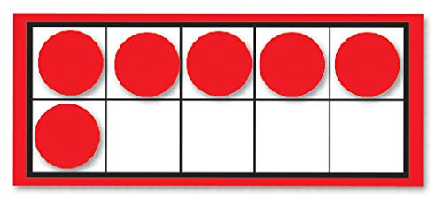
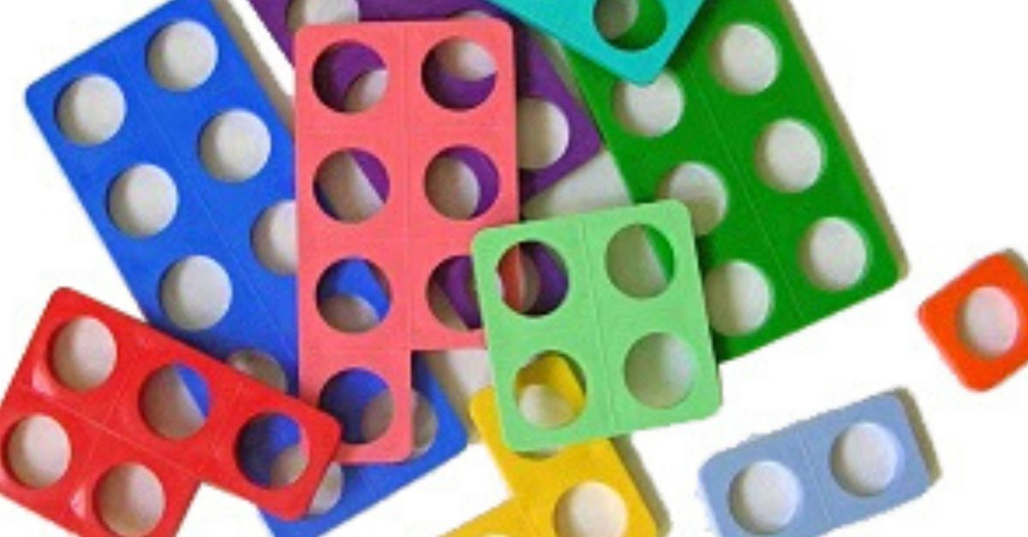
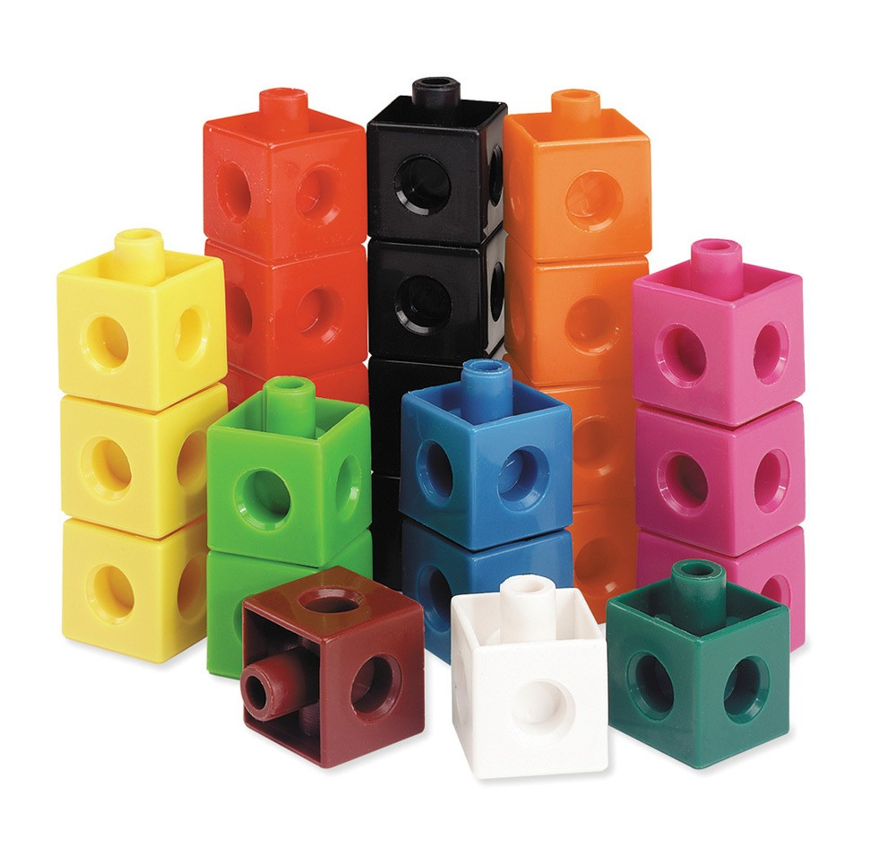
Maths in school
We follow the White Rose Maths scheme. We use lots of resources to help with our learning such as Unifix, tens frames and Numicon.
We will have daily Maths lessons as a class then complete Maths tasks in small groups with an adult.

Slide 12
Home Learning
Keep It Play-Based
At this age, play is learning. Children develop best through hands-on, meaningful play.
Use role-play (shops, doctors, cooking).
Build with blocks, LEGO, or junk modelling.
Explore outdoors - nature walks, scavenger hunts, water play.
Tip: Follow their interests – dinosaurs, cars, animals – and turn them into learning opportunities.
Reading Every Day
Reading is the most important daily habit. - Read to them every day – even if they don’t read yet.
- Re-read favourites to build vocabulary and comprehension.
Point to words as you read; talk about the story and characters.
Let them handle books, turn pages, guess what happens next.
Tip: Ask simple questions like “What do you think will happen next?” or “How do you think he feels?”
Writing Through Play
Formal writing isn’t needed yet, but you can build skills:
Encourage mark-making: chalk, paint, whiteboards.
Write shopping lists together.
Encourage name writing.
Provide scissors, glue, and paper for cutting and sticking.
Tip: Focus on pencil grip and finger strength with playdough or tweezers.
Everyday Maths
Embed maths into daily life.
Count everything (stairs, apples, buttons).
Use maths language: more, less, bigger, smaller.
Sort objects by colour/shape/size.
Play board games, dice games, and puzzles.
Tip: Use songs and rhymes with numbers (e.g. “Five Little Ducks”).
Routine & Wellbeing
Reception is a big change – keep things calm and predictable.
Keep a simple daily routine.
Allow plenty of rest and quiet time.
Celebrate small wins and effort over perfection.
Encourage independence with dressing, tidying, and toileting.
Tip: Don’t worry if they’re tired – Reception is full-on!
Speaking & Listening
Children learn through conversation.
Talk about your day and theirs.Ask open-ended questions: "What did you enjoy most today?“
Play “Simon Says” or describe-and-draw games.
Encourage storytelling or role-play with toys.
Tip: Avoid “yes/no” questions; encourage full sentences.
Don’t Overdo It
Keep home learning short, fun, and pressure-free.
- 10–15 minutes per activity is enough.
- It’s okay to miss a day.
- Focus on enjoying time together and building a love of learning.
Optional Resources
Oxford Owl: Free eBooks & phonics games.
CBeebies Numberblocks & Alphablocks
Teach Your Monster to Read (free on desktop)

Slide 13
Share your learning
Be organised
Take pride in your learning
Share your learning
Aim high
Cooperation
Master a new skill
Be kind
Encourage others
Challenge yourself
Ask questions
Care for our environment
Be a good friend
We are looking forward to a fabulous year!
Any Questions?
Solve problems
Have a go!
Make good choices
Use your imagination
Be determined
Excellent home learning
Use kind words
Resilience
Take pride
Be curious

